Slide 1
Dietetics is a Great Career!
Notes:
Hi! My name is [NAME]. I work as [EXPLAIN POSITION AND TITLE]. I’m also a member of the Academy of Nutrition and Dietetics and a Diversity Ambassador for the South Carolina Academy of Nutrition and Dietetics. Today, I’m going to be talking to you about the exciting profession of food, nutrition and dietetics. As a college student, you may wonder whether the profession of food, nutrition and dietetics is a good choice for you. But, what exactly is the field of food, nutrition and dietetics and how do you get into it? During my presentation today, I will highlight some of the various roles, positions and professions that are all part of the food, nutrition and dietetics field. We’ll also review where you can find more information through the Academy of Nutrition and Dietetics. Okay! Let’s get started.

Slide 2
I Want that Job!
Notes:
First, I want to show you a brief video to introduce you to the job of a dietitian.
(WHEN IN “SLIDE SHOW” VIEW, CLICK ANYWHERE IN “SCREEN” BOX TO PLAY VIDEO.)
(WHEN IN “NORMAL VIEW” use curser to click on White right-pointing arrow in black DOT below word “dietitian” to play brief video.)

Slide 3
Get to Know the Speaker
Notes:
[PERSONALIZE SLIDE BASED ON YOUR POSITION AND SPECIALITY IN THE FIELD] Again, my name is [NAME]. [EXPLAIN WORK SETTING, POSITION, TITLE, ORGANIZATION YOU WORK FOR. HIGHLIGHT DIFFERENT POSITIONS YOU’VE HELD. KEEP THIS SLIDE TO UNDER 2 MINUTES AS THIS SHOULD ONLY BE HIGHLIGHTS OF YOUR CAREER – TAILOR TO AUDIENCE AS NEEDED.]

Slide 4
What is Dietetics?
Dietetics is the science and art of applying the principles of food and nutrition to health.
Positions in the field of nutrition and dietetics include:
Registered Dietitian Nutritionist (RDN or RD)
Nutrition and Dietetic Technician, Registered (NDTR or DTR)
Notes:
You might be wondering, what is dietetics? Dietetics is the science and art of applying the principles of food and nutrition to health. Dietetics is using science, research and data to best understand how nutrition and food can help us live healthier lives. Positions in the field include Registered dietitians or Registered dietitian nutritionists. Other positions in the field include Dietetic technicians, registered or Nutrition and dietetic technicians, registered.
(Definition found: http://www.eatrightpro.org/resources/about-us/become-an-rdn-or-dtr)

Slide 5
Dietetics – Where You Might Work
Hospitals/medicine
Sports/fitness
Restaurants/Supermarkets
Public health
Food service (school, hospital)
Universities (teach)
Research
Marketing/public relations
Agriculture
Food manufacturing
Government
Long-term care
Private counseling practice
Notes:
Working in the field of nutrition and dietetics will offer you a lot of flexibility. You can work in a variety of settings such as in hospitals with patients, in sports with athletes, in restaurants or supermarkets, in public health with underserved populations, in foodservice in schools or hospitals, in universities to teach, in research, in marketing or public relations, in agriculture, in food manufacturing, in government, in long-term care, or you could run your own private counseling practice. And most importantly, by educating people to make nutritious decisions and live healthier lives, you will be helping people and making a difference in the world.
[INSERT A PERSONAL STORY HERE TO DESCRIBE WHY YOU WENT INTO DIETETICS]

Slide 6
Who Are We?
www.eatright.org
www.eatrightpro.org
Notes:
The Academy of Nutrition and Dietetics – or Academy for short, is the organization for food, nutrition and dietetics professionals. It exists to support you throughout your career, beginning when you’re a student. The Academy supports its members when they are students and throughout their careers in the profession. The Academy supports those in the profession by conducting and funding nutrition research, providing profession-wide standards, offering educational opportunities and connecting those in the field to each other.
The Academy has two websites. Eatright.org is the website for consumers. Eatrightpro.org is the website for professionals in the field.

Slide 7
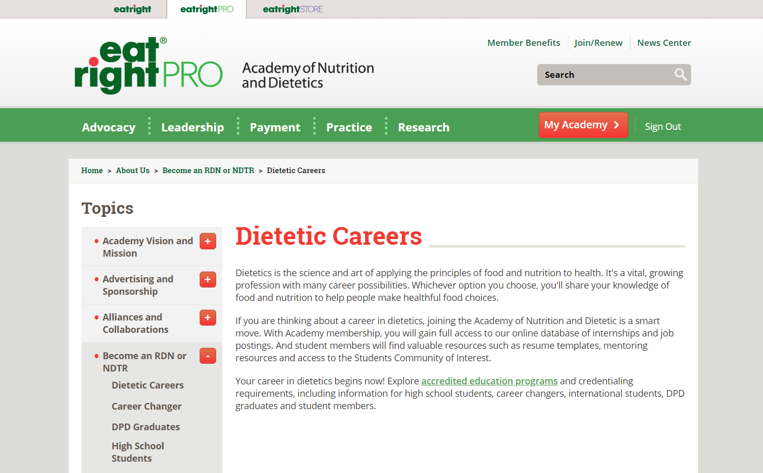
www.eatrightPRO.org
Notes:
As you begin to consider your future career, check the Academy’s professional site: www.eatrightPRO.org where you can learn about careers in dietetics.

Slide 8
www.eatrightACEND.org
Notes:
For those of you considering a career in dietetics, check out www.eatrightacend.org. On this website, you will find a list of accredited educational programs that will get you into the field of food, nutrition, and dietetics. To become a Registered dietitian nutritionist or a dietetic technician, registered, you will need to graduate from one of these programs. One must also pass a specialized exam to become either a registered dietitian nutritionist or a nutrition and dietetic technician, registered. Those who become a registered dietitian nutritionist must also complete a practice-based experience typically referred to as an internship.

Slide 9
Registered Dietitian Nutritionist
Education and Professional Requirements
Complete a minimum of a Master’s degree at a US regionally accredited university or college and course work accredited by the Accreditation Council for Education in Nutrition and Dietetics (ACEND®) of the Academy of Nutrition and Dietetics.
Notes:
Let’s go over the education and professional requirements for Registered Dietitian Nutritionists, the food and nutrition experts who have met the following four criteria to earn and maintain the RD or RDN credential:
First, Registered Dietitian Nutritionists must complete a minimum of a Master's degree at a US regionally accredited university or college and course work accredited by the Accreditation Council for Education in Nutrition and Dietetics (ACEND®) of the Academy of Nutrition and Dietetics.
For college coursework, dietitians study a variety of subjects, ranging from food and nutrition sciences, foodservice systems management, business, economics, computer science, culinary arts, sociology and communication to science courses such as biochemistry, physiology, microbiology, anatomy and chemistry.

Slide 10
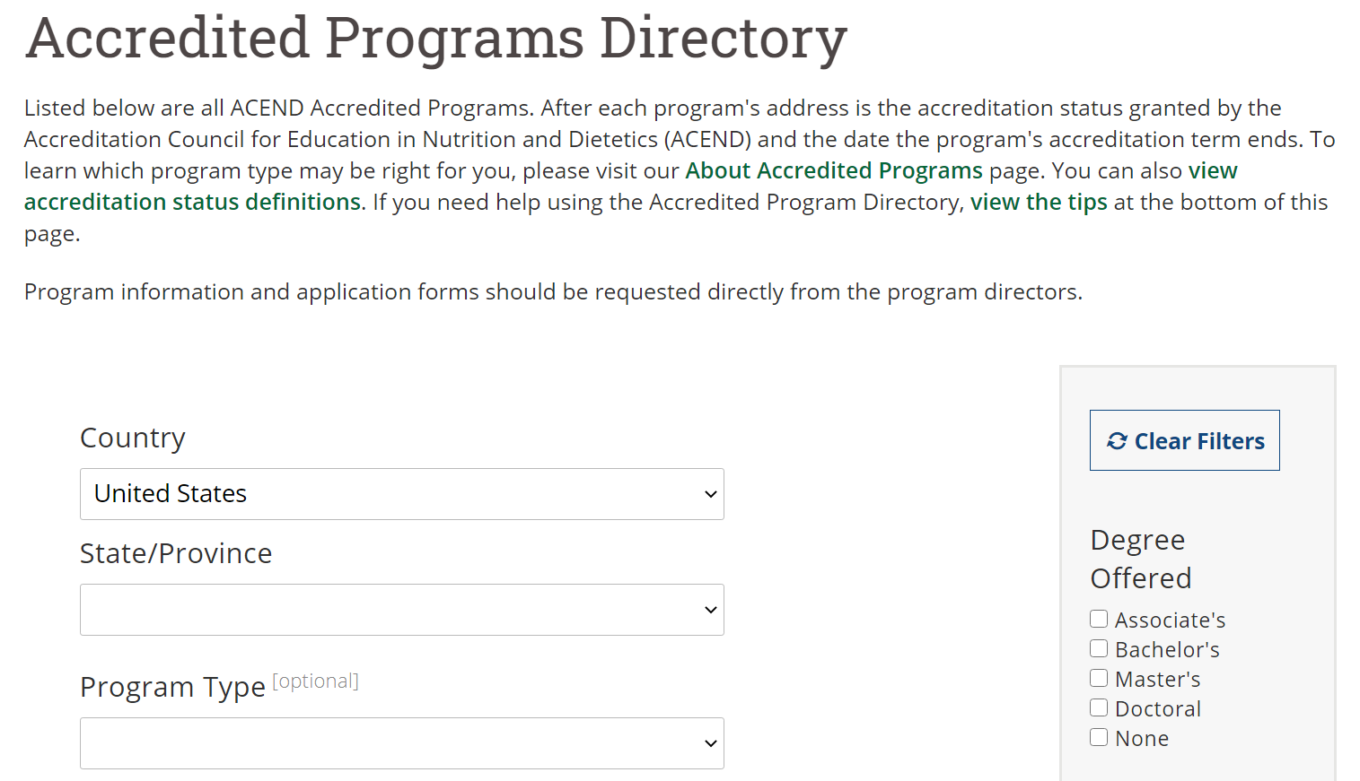
Accredited Programs Directory (eatrightpro.org)
Notes:
A Directory of ACEND Accredited Programs is available on the Academy’s website. Simply go to eatrightpro.org and search on “Accredited Programs Directory.” You can use drop-down lists to search by state or program type.
Several ACEND-accredited programs offer the option to complete program requirements via distance education. To identify them, on the Accredited Programs Directory, check the box for “Distance Education” (not shown on the slide because it is further down) in the gray-shaded area on the right-side of the page.

Slide 11
Registered Dietitian Nutritionist
Education and Professional Requirements
Complete an ACEND®-accredited supervised practice program at a health-care facility, community agency, or a foodservice corporation or combined with undergraduate or graduate studies. A typical practice program lasts six to 12 months.
Notes:
Second, Registered Dietitian Nutritionists must complete an ACEND®-accredited supervised practice program at a health-care facility, community agency, or a foodservice corporation. This supervised practice program can be combined with undergraduate or graduate studies. A typical practice program lasts 6 to 12 months.

Slide 12
Registered Dietitian Nutritionist
Education and Professional Requirements
Pass a national examination administered by the Commission on Dietetic Registration (CDR). For more information about the examination, refer to CDR’s website at www.cdrnet.org.
Notes:
Third, Registered Dietitian Nutritionists must pass a national examination administered by the Commission on Dietetic Registration (CDR). For more information regarding the examination, refer to CDR's website.

Slide 13
Registered Dietitian Nutritionist
Education and Professional Requirements
Complete continuing professional educational requirements to maintain registration.
Notes:
Fourth, Registered Dietitian Nutritionists must complete continuing professional educational requirements to maintain registration and keep up to date on nutrition knowledge. This can be done any number of ways from small group meetings to reading articles in professional journals to online webinars to large conferences attended in person.

Slide 14
Registered Dietitian Nutritionist
Additional Certifications
Some hold additional certifications in specialized area of practice.
These certifications are awarded through CDR and/or other medical and nutrition organizations.
These certifications are recognized within the profession but are not required.
Some certifications include pediatric nutrition, renal nutrition, sports dietetics, nutrition support and diabetes education.
Notes:
Some Registered Dietitian Nutritionists hold additional certifications in specialized areas of practice. These certifications are awarded through the Commission on Dietetic Registration or CDR, the credentialing agency for the Academy, and/or other medical and nutrition organizations. These certifications are recognized within the profession but are not required. Some of the certifications include pediatric or renal nutrition, sports dietetics, nutrition support and diabetes education.

Slide 15
Registered Dietitian Nutritionist
Salaries and Job Outlook
Median full-time salary $68,600 per year
Salaries increase with years of experience
Those in management and business may earn more than $90,000 per year
Employment projected to grow 8% from 2019 to 2029, much faster than average for all occupations
Notes:
According to the Academy's 2019 Compensation and Benefits survey of the Dietetics Profession, the median full-time salary of all Registered Dietitian Nutritionists was $68,600 per year. As with any profession, salaries and fees vary by region of the country, employment settings, scope of responsibility and supply of dietitians. Salaries increase with years of experience. Registered dietitian nutritionists in management and business may earn more than $90,000 per year.
According to the US Bureau of Labor Statistics, employment of dietitians is projected to grow 8% from 2019 to 2029. This is much faster than average for all occupations and due to several things -- the increased emphasis on the role of food and nutrition in preventing and treating diseases, a growing and aging population, and public interest in nutrition.

Slide 16
Nutrition and Dietetic Technicians, Registered
Education and Professional Requirements
Complete a dietetic technician program accredited by ACEND® of the Academy of Nutrition and Dietetics, that includes 450 hours of supervised practice experience in various community programs, health-care and foodservice facilities and at least a two-year associate’s degree at a US regionally accredited college or university.
Notes:
Let’s go over the education and professional requirements for Nutrition and Dietetic Technicians, Registered, who are an integral part of the health-care and food service management teams and have met the following four criteria to earn and maintain the DTR or NDTR credential:
First, Nutrition and Dietetic Technicians, Registered must complete a dietetic technician program accredited by ACEND of the Academy of Nutrition and Dietetics. The program must include 450 hours of supervised practice experience in various community programs, health-care and foodservice facilities and include at least a two-year associate’s degree at a U.S. regionally accredited college or university.
The associate degree course work for dietetic technicians includes a variety of classes in food and nutrition sciences, foodservice systems management and a range of general science courses.

Slide 17
Nutrition and Dietetic Technicians, Registered
Education and Professional Requirements
Or, Complete an ACEND accredited didactic program or coordinated program in dietetics and at least a bachelor’s degree at a US regionally accredited college or university or foreign equivalent.
Notes:
Second, or, Nutrition and Dietetic Technicians, Registered must complete an ACEND accredited didactic program or coordinated program in dietetics and at least a bachelor’s degree at a U.S. regionally accredited college or university or foreign equivalent.

Slide 18
Nutrition and Dietetic Technicians, Registered
Education and Professional Requirements
Pass a national examination administered by CDR. For more information about the examination, refer to CDR’s website at www.cdrnet.org.
Notes:
Third, Nutrition and Dietetic Technicians, Registered must pass a national examination administered by the Commission on Dietetic Registration. For more information regarding the examination, refer to CDR’s website at www.cdrnet.org.

Slide 19
Nutrition and Dietetic Technicians, Registered
Education and Professional Requirements
Complete continuing professional educational requirements to maintain the credential.
Notes:
Fourth, Nutrition and Dietetic Technicians, Registered complete continuing professional educational requirements to maintain their credential. This can be done any number of ways from small group meetings to online webinars to large conferences attended in person.

Slide 20
Nutrition and Dietetic Technicians, Registered
Salaries and Job Outlook
Median full-time salary $46,700 per year
Salaries increase with years of experience, budget responsibility and practice
Those in community positions reported lowest wages and those in management reported highest wages
Employment projected to grow 8% from 2019 to 2029, much faster than average for all occupations
Notes:
Nutrition and Dietetic Technicians, Registered work independently as team members under the supervision of registered dietitians.
According to the Academy's 2019 Compensation and Benefits survey of the Dietetics Profession, the median full-time salary of all Nutrition and Dietetic Technicians, Registered was $46,700 per year. Factors that were strongly associated with salaries included years of experience, supervisory and budget responsibility and practice area, as Nutrition and Dietetic Technicians, Registered in community positions reported the lowest median wage while those in food and nutrition management reported the highest median wage.
According to the US Bureau of Labor Statistics, employment of dietetic technicians is projected to grow 8% from 2019 to 2029. This is much faster than average for all occupations and due to several things -- the increased emphasis on the role of food and nutrition in preventing and treating diseases, a growing and aging population, and public interest in nutrition.

Slide 21
Diversity and Inclusion
Notes:
The Academy has made it a priority to increase diversity and inclusion in the nutrition and dietetics profession. Why is this important? Everyone eats, and eating habits are affected by cultural norms and practices related to race, ethnicity, gender, religion, disability status, etc. It is important for the nutrition and dietetics profession to better reflect the population of the United States so we are better equipped to help people improve their eating habits and live more healthful lives.

Slide 22
Diversity and Inclusion
Percentage
Notes:
This graph compares percentages of the population in the United States (the blue bars) to that of dietitians in the United States (the red bars) and to dietitians in South Carolina (the green bars). This graph shows that the demographics of our profession do not reflect the demographics of the United States population. It is easy to see that the dietetics profession needs more men and especially needs more individuals from diverse groups such as Black, Latinx, Asian.

Slide 23
Notes:
Finally, I’d like to share a 6-minute video that shares some of the roles and responsibilities of dietitians during the COVID-19 pandemic and making a difference during this unprecedented time! This video is very important because it features dietitians from diverse groups. Remember, there is a huge need to have more dietitians and dietetic technicians who are Black, Hispanic or Latino, or from other diverse groups.
(WHEN IN “SLIDE SHOW” VIEW, CLICK ANYWHERE IN “SCREEN” BOX TO PLAY VIDEO.)
(use curser to click on White right-pointing ON BLACK DOT TO PLAY VIDEO WHEN IN NORMAL VIEW.)

Slide 24
Academy Contact Information
Academy of Nutrition and Dietetics
Website: www.eatrightPRO.org
Email: membership@eatright.org
Accreditation Council for Education in Nutrition and Dietetics (ACEND)
Website: www.eatrightACEND.org
Email: acend@eatright.org
Notes:
For more information about a career as a Registered Dietitian Nutritionist or a Nutrition and Dietetic Technician, Registered, visit the Academy’s website, or email membership@eatright.org.
For more information about an accredited program to become a Registered Dietitian Nutritionist or a Nutrition and Dietetic Technician, Registered, visit the ACEND website or email acend@eatright.org.

Slide 25
Questions?
Notes:
Thanks for letting me talk to you about a career in the field of food, nutrition and dietetics.
Questions?

